Slide 1

Milwaukee Property Search Dashboard
Data visualization project using SQLite, Python, MongoDB, Flask, JS, HTML, ML

Slide 2


Presenters
Elle Behnia
Navneet Kaur
Vivek Sarraf
Ajunjee Selvam

Slide 3
Project Objective
Interactive UI that provides information on Milwaukee property listings to help users make informed decisions for purchasing residential properties within this area.
Milwaukee Property Insights:
Get immediate access to detailed property information predicted 2025 house price
Customizable Searches:
Filter properties by the number of bedrooms to find exactly what you need.
User-Friendly:
Designed for simplicity, our dashboard makes finding and analyzing Milwaukee properties intuitive and effective.

Slide 4
Dataset and Limitations
No Free Toronto dataset found for our Requirements !
Dataset 1: Milwaukee Open Data - Individual Property Sales Data from 2013 to 2023
~46,000 records before cleaning → ~37,000 records after cleaning
Columns: 'district', 'nbhd', 'style', 'extwall', 'stories', 'year_built', 'rooms', 'finishedsqft', 'units', 'bdrms', 'fbath', 'hbath', 'lotsize','sale_date', 'sale_price'
Issues: null values, 0s, and incomplete/inaccurate data
Dataset 2: Kaggle - 2023 United States House Listings: Zillow Extract
Filtered for Milwaukee
Columns: finishedsqft', 'bdrms', ‘baths’, 'lotsize', ‘state’, ‘city’, ‘address’, ‘zipcode’, ‘latitude’, ‘longitude’, ‘ppsq’, ‘convertedlot’, ‘lotunit’, ‘marketestimate’, rentestimate’, ‘price’
Issues: null values, 0s, incomplete data
Required manual population based on similar characteristics
Large difference in features may result in inaccurate 2025 house price forecast predictions

Slide 5
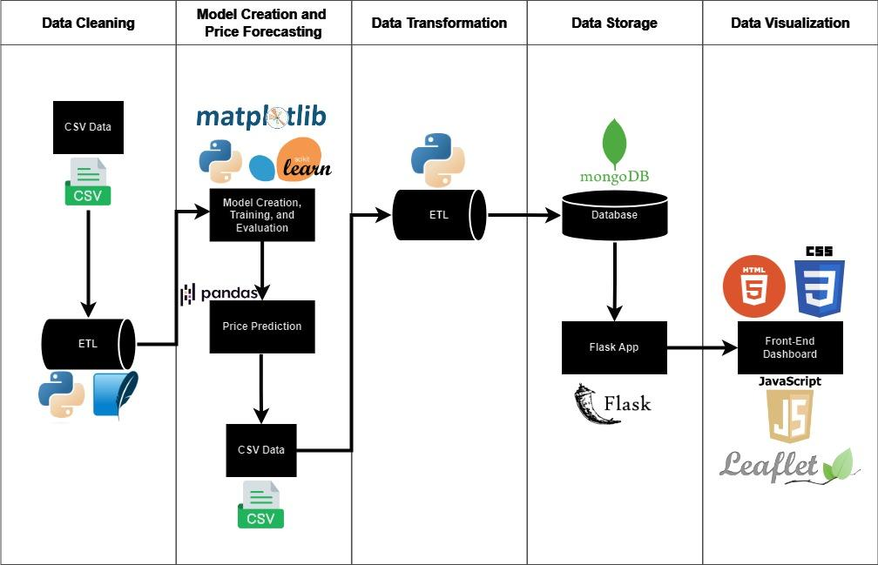
Architecture
Notes:
Cleaning
SQLite and python for cleaning data
Model
Matplotlib and statsmodels for visualizing features and determining coefficients and p-values
Scikit-learn - random forest regression model
Database
NOSQL Database MongoDB.
Python Flask-powered API
To fetch data from MongoDB and render the HTML template.
Python Libraries
flask_pymongo - To bridge pymongo and Flask and provide some helper functions.
Python using Pandas Jupyter Notebook
To Transform and clean the data.
HTML / CSS
For the index.html layout to render our maps and forms.
Javascript Libraries
Leaflet - To display Interactive tiled web maps.

Slide 6
Data Model Optimization
Model Information | Performance
Linear Regression Trained with all 53 input features | Accuracy: 0.55 Mean Squared Error: 3657767974.09

Slide 7
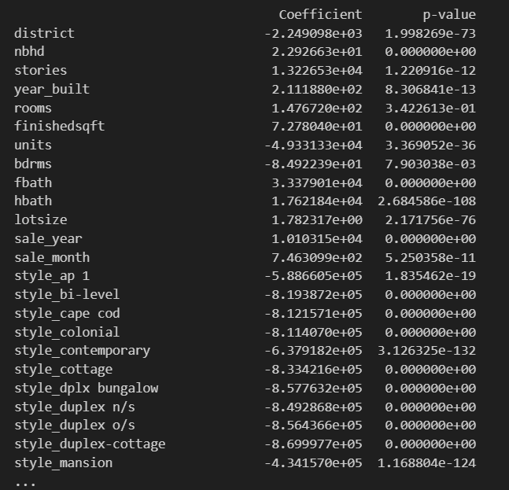
Data Model Optimization - Coefficients and P-Values

Slide 8
Data Model Optimization
Model Information | Performance
Random Forest Regressor Trained with all 53 input features | Accuracy: 0.8365 Mean Squared Error: 1497358586.32

Slide 9
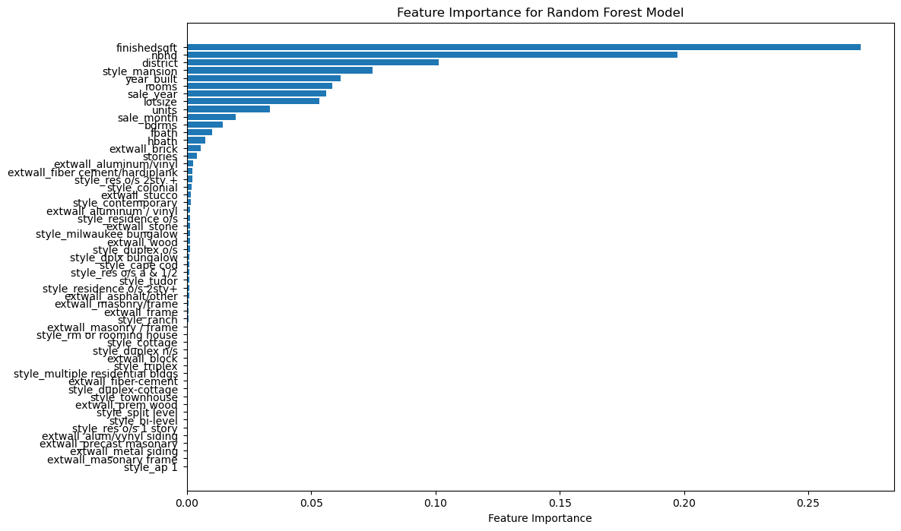
Data Model Optimization - Feature Importance

Slide 10
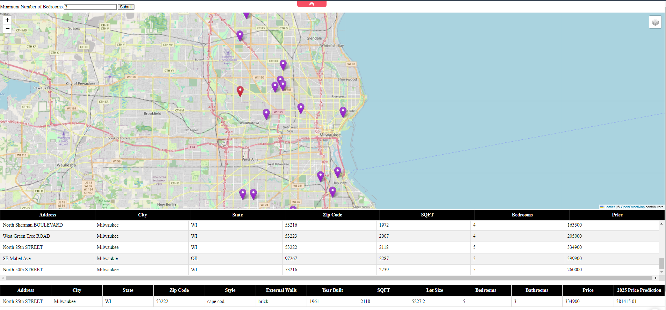
Live Demonstration

Slide 11
Future Improvements
Toronto data
More relevance and applicability
Paid datasource
Data reliability and completeness
Dashboard Improvements
Additional filter logic
Other points of interests
Styling and layout
Notes:
Speaker: Ajunjee

Slide 12
Thank you! Questions?

